Slide 1
HTML5: What’s New?

Slide 2
<!DOCTYPE html>

Slide 3
Semantic <div> tags
<section>
<aside>
<header>
<footer>
<nav>
<dialog>
<figure>

Slide 4
<canvas>
Drawing element that renders raster graphics
Similar to Paint, not Photoshop – once you draw it, you cannot reference or modify it (besides drawing over it)
2D Example: www.wheelspoking.com
There’s a 3D Open-GL version, too (browser support may vary): http://slides.html5rocks.com/#canvas-3d

Slide 5
Multimedia
<audio>
<video>
<embed>

Slide 6
Data
<meter>
<time>
<datagrid>
<details>
<datalist>
<output>

Slide 7
New Input Types
<input type=‘datetime’>
<input type=‘datetime-local’>
<input type=‘date’>
<input type=‘month’>
<input type=‘week’>
<input type=‘time’>
<input type=‘number’>
<input type=‘range’>
<input type=‘email’>
<input type=‘url’>

Slide 8
New Global Attributes
Some of these were available in certain HTML4 elements, but now apply to all elements
contenteditable
contextmenu
draggable
irrelevant

Slide 9
Offline Support (Application Cache)
HTML5 allows the specification of a manifest file that tells compatible browsers what it needs to cache locally for offline functionality
Using the cache interface gives your application three advantages:
Offline browsing - users can navigate your full site when they're offline
Speed - cached resources are local, and therefore load faster.
Reduced server load - the browser will only download resources from the server that have changed.
http://www.html5rocks.com/en/tutorials/appcache/beginner/
Used extensively in Firefox Marketplace https://www.mozilla.org/en-US/apps/
Allows a simple bookmark to serve as a ‘hybrid app’ for iOS, Android, FirefoxOS, ChromeOS and anything that supports the HTML5 AppCache

Slide 10
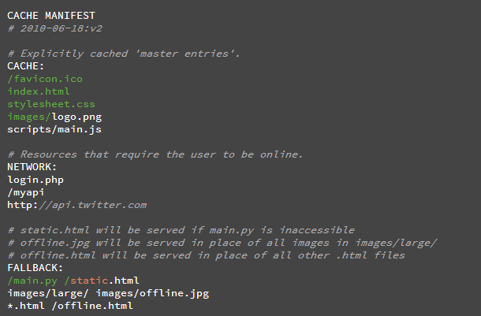
AppCache Example
<html manifest="example.appcache">

Slide 11
Local Storage
window.localStorage.setItem(‘key’, value);
window.localStorage.getItem(‘key’);

Slide 12
Support!!!
Various browsers have different levels of support for each tag, but in general the following support most of HTML5:
IE8+ (except canvas, use IE9 or ExCanvas), Chrome 28+, Opera 14, Gecko 22+ (Firefox), WebKit 534.20+ (Safari, Chrome, Android and iOS browsers)
Windows 8 Store (including phone) – Microsoft allows the choice between XAML/C# and HTML5/JS using a projection of the Windows API in Javascript (file system access in JavaScript!) called WinJS http://dev.bennage.com/blog/2012/08/01/a-brief-introduction-to-winjs/
FirefoxOS – A lightweight HTML5/CSS/JS phone OS for lower hardware https://developer.mozilla.org/en-US/docs/Mozilla/Firefox_OS

Slide 13
See what HTML5 can do
Mozilla has written an entire online multiplayer game in HTML5 with especially the 2D <canvas> and <audio> tags called BrowserQuest http://browserquest.mozilla.org/
Completely open source (MPL): https://github.com/mozilla/BrowserQuest

Slide 14
